Slide 1
SANTANDER
Costumer Satisfaction

Slide 2
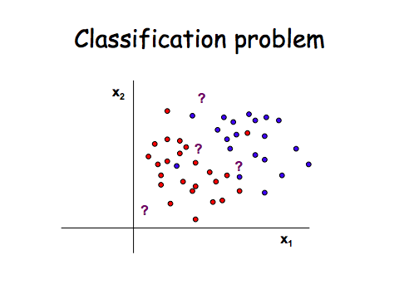
Business Problem
From frontline support teams to C-suites, customer satisfaction is a key measure of success. Unhappy customers don't stick around. What's more, unhappy customers rarely voice their dissatisfaction before leaving.
Santander Bank is asking Kagglers to help them identify dissatisfied customers early in their relationship. Doing so would allow Santander to take proactive steps to improve a customer's happiness before it's too late.
In this competition, you'll work with hundreds of anonymized features to predict if a customer is satisfied or dissatisfied with their banking experience.

Slide 3
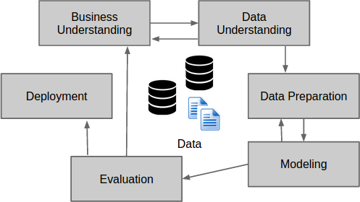
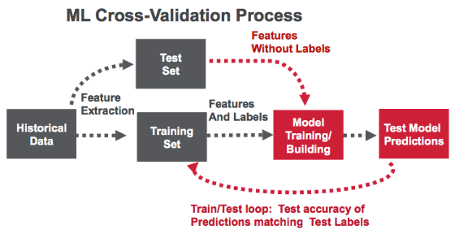
Data Science Life Cycle

Slide 4
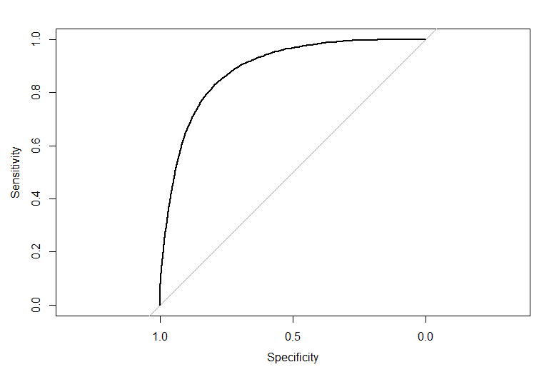
XGBoost
Area under the curve: 88.9%
Mean Error: 0.2034728
Accuracy: 79.7%
Actual/Predicted | NO | YES
NO | 58,060 | 14,952
YES | 516 | 2,492

Slide 5
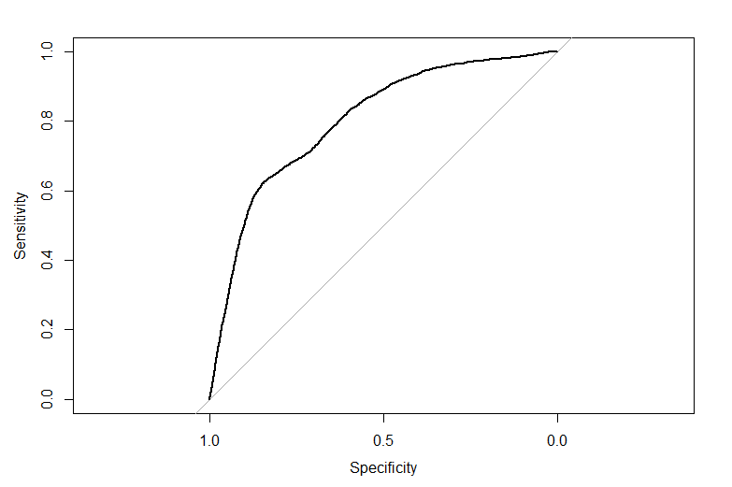
Elastic Net
Area under the curve: 80.4%
Mean Error: 0.1642068
Accuracy: 83.6%
Actual/Predicted | NO | YES
NO | 61,660 | 11,352
YES | 1,131 | 1,877

Slide 6
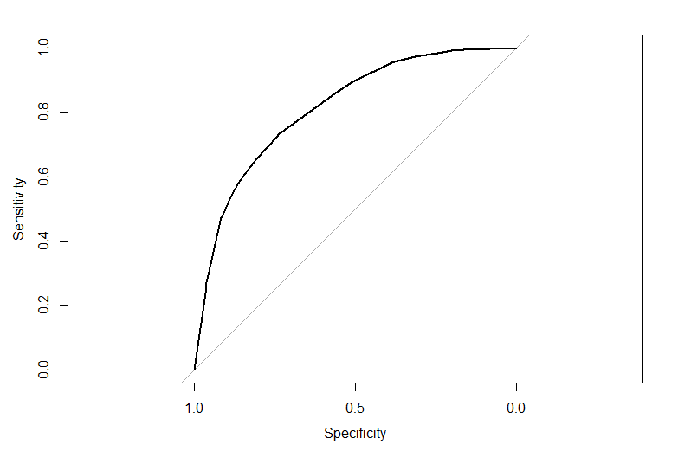
Classification Tree
Area under the curve: 81.4%
Mean Error: 0.2616154
Accuracy: 83.6%
Actual/Predicted | NO | YES
NO | 53,935 | 19,077
YES | 811 | 2,197

Slide 7
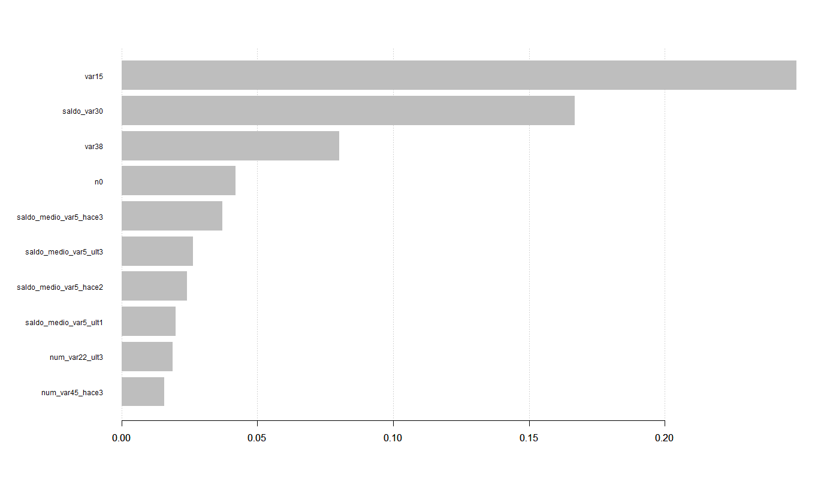
Feature importance
Var15 is the most important feature for XGBoost Algorithm
Importance is calculated for a single decision tree by the amount that each attribute split point improves the performance measure, weighted by the number of observations the node is responsible for. The performance measure may be the purity (Gini index) used to select the split points or another more specific error function.
Notes:
The feature importance's are then averaged across all of the decision trees within the model.
Var15 is the
Generally, importance provides a score that indicates how useful or valuable each feature was in the construction of the boosted decision trees within the model. The more an attribute is used to make key decisions with decision trees, the higher its relative importance.

Slide 8
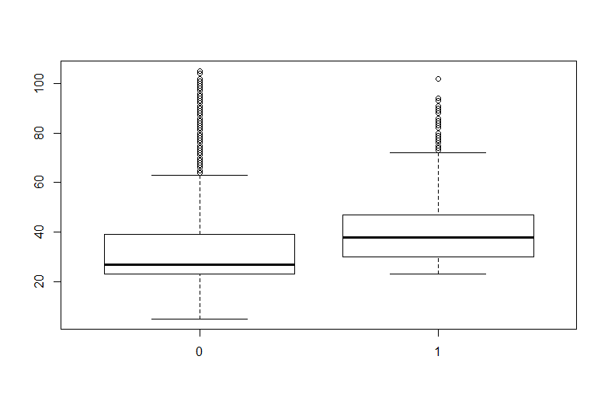
Var15
The effect var15 has in TARGET is statistically significant (sig = 0.05)
Consumers with higher var15 have higher satisfaction
If there is some control over this variable, then SANTADER should make sure it’s value is high

Slide 9
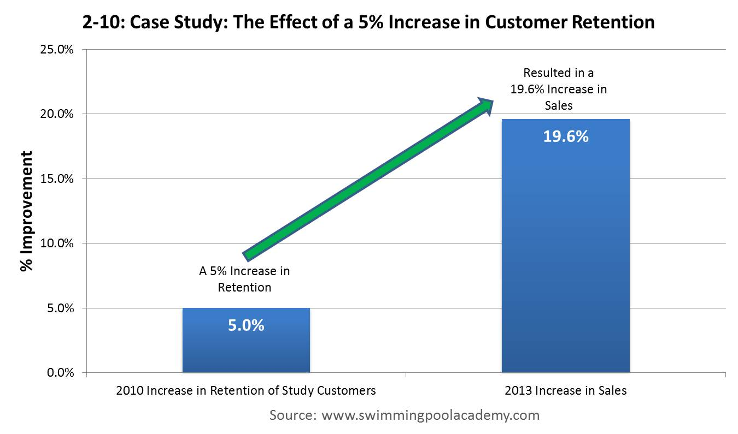

Why is this important
Early Churn detection is the most important fact to growth.
Depending on industry, a new costumer costs on average 5 times more than the cost to keep an existing one.

